Slide 1
Prompting
“The hottest new programming language is English”
-Andrej Karpathy

Slide 2
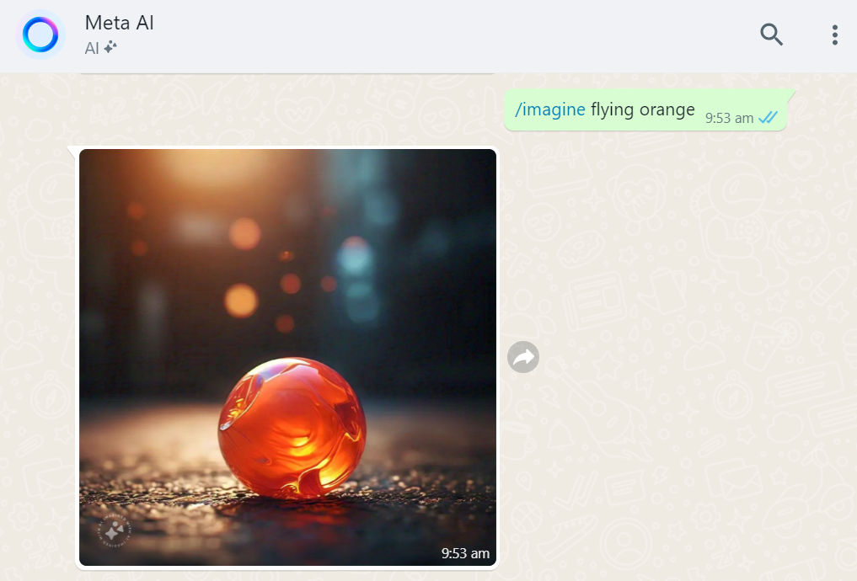
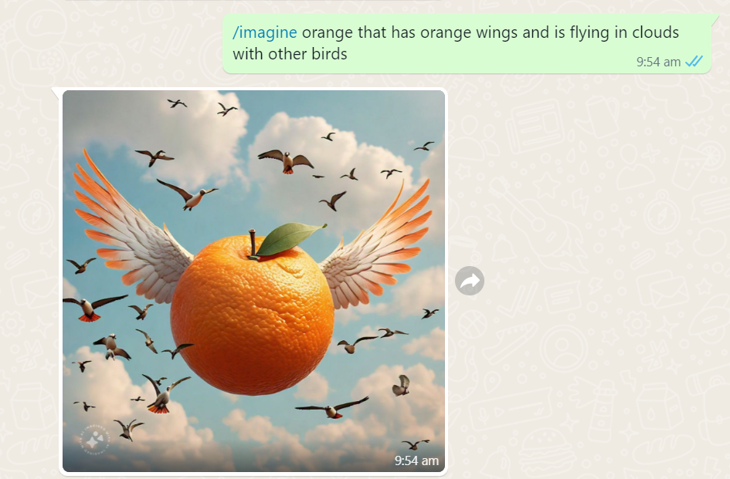

Slide 3
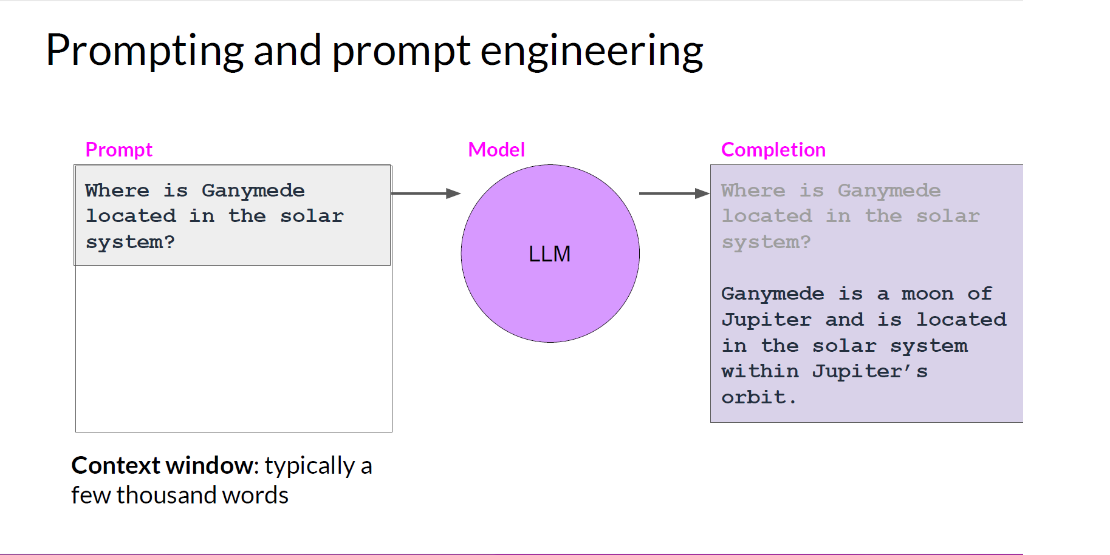
Generative AI & Large Language Models- deeplearning.ai

Slide 4
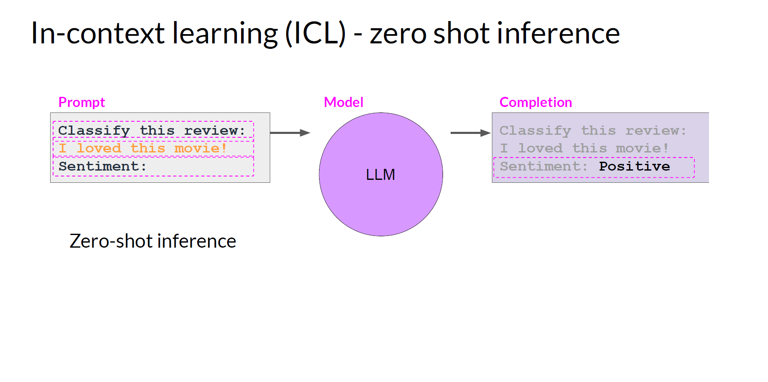
Generative AI & Large Language Models- deeplearning.ai

Slide 5
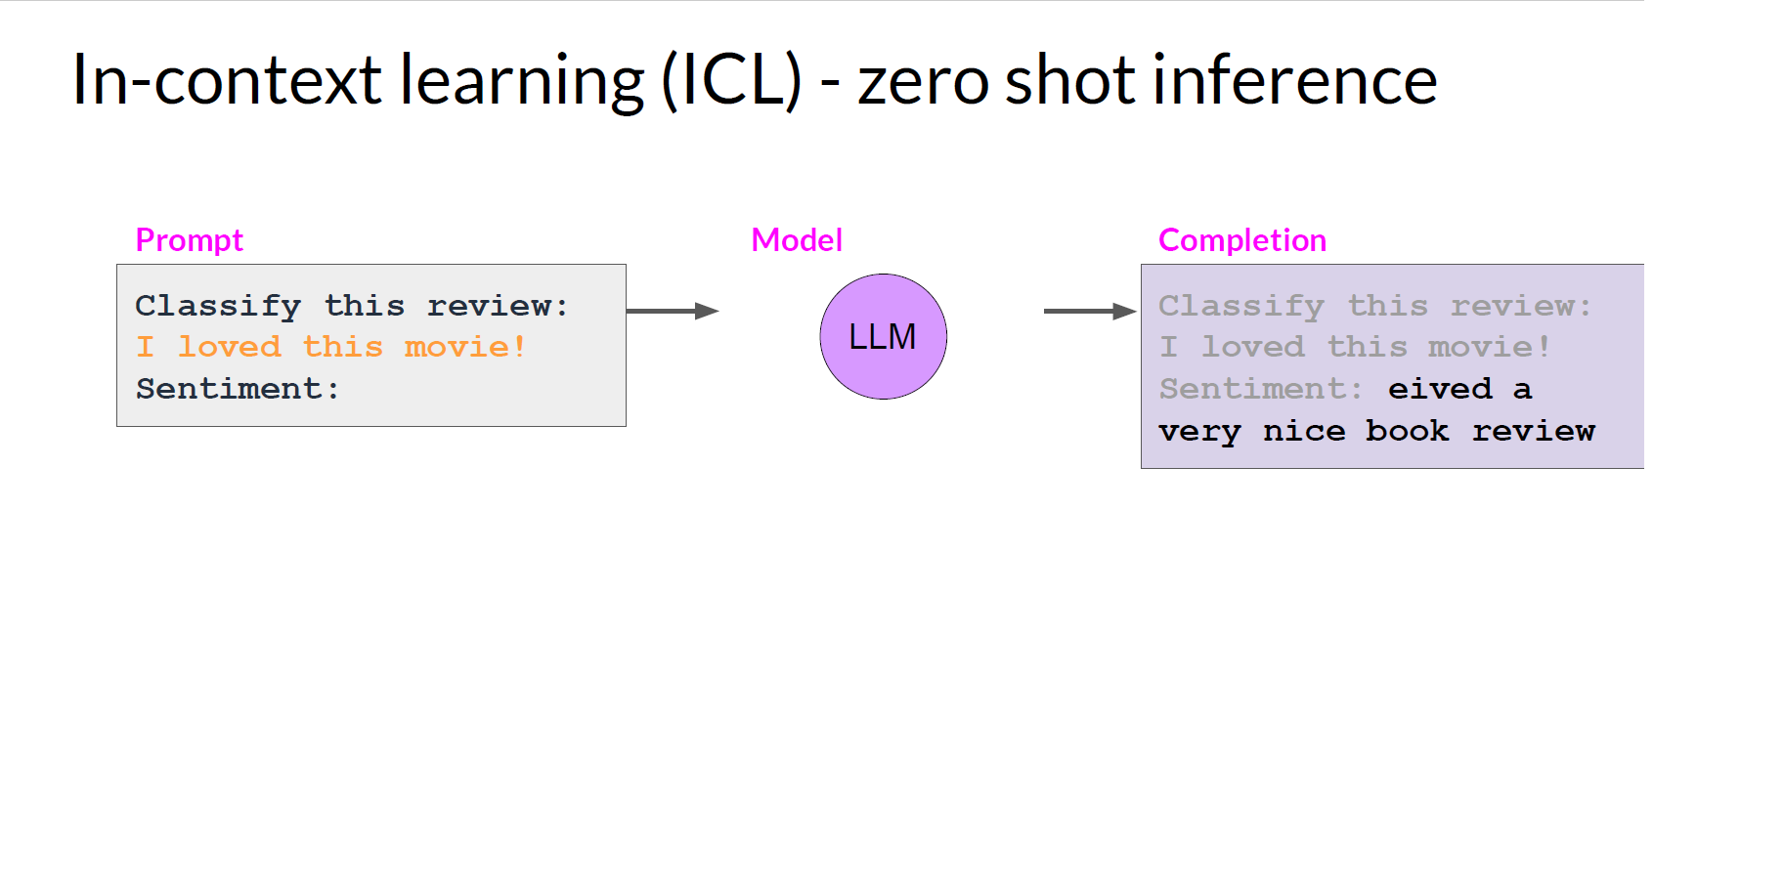
Generative AI & Large Language Models- deeplearning.ai

Slide 6
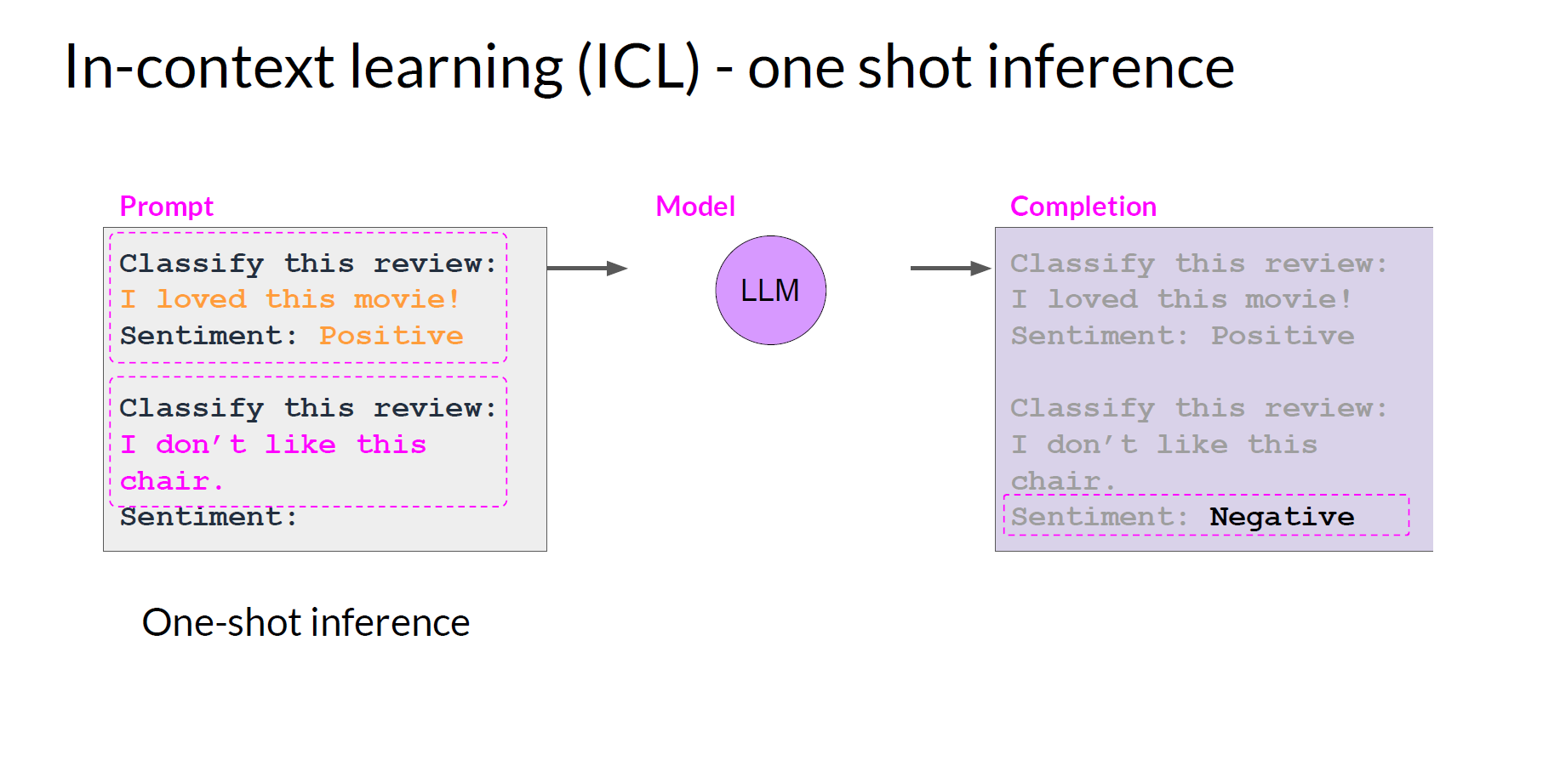
Generative AI & Large Language Models- deeplearning.ai

Slide 7
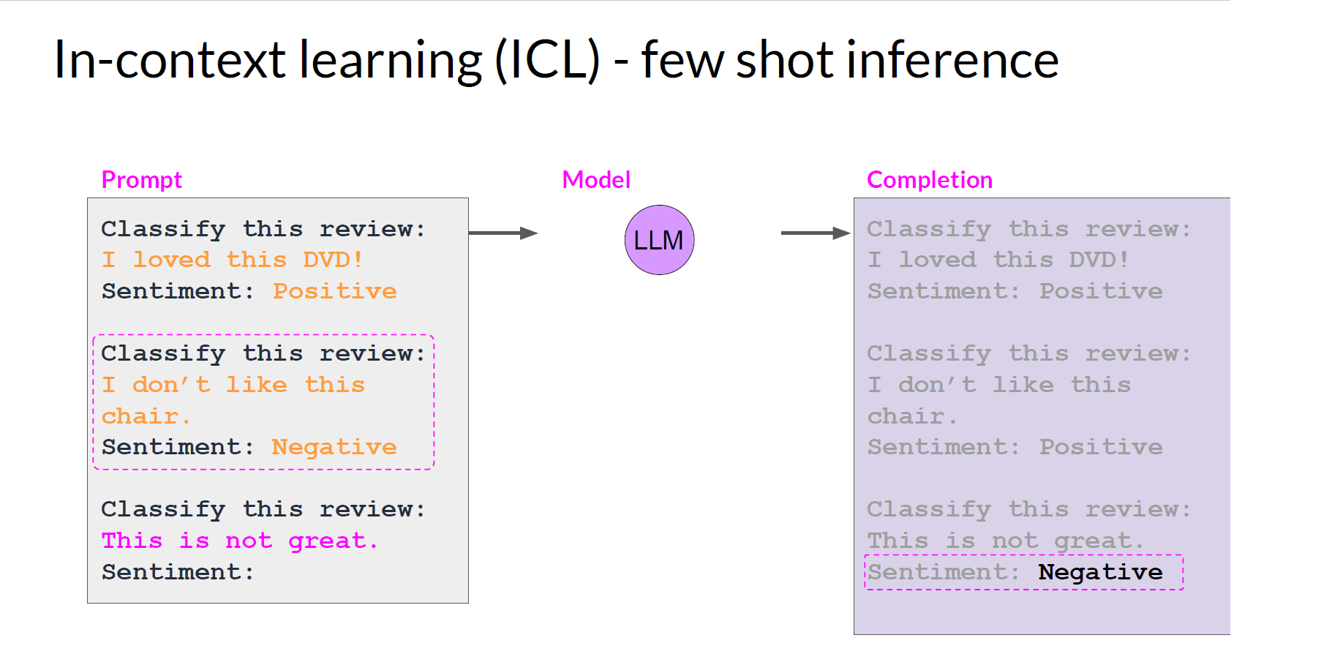
Generative AI & Large Language Models- deeplearning.ai

Slide 8
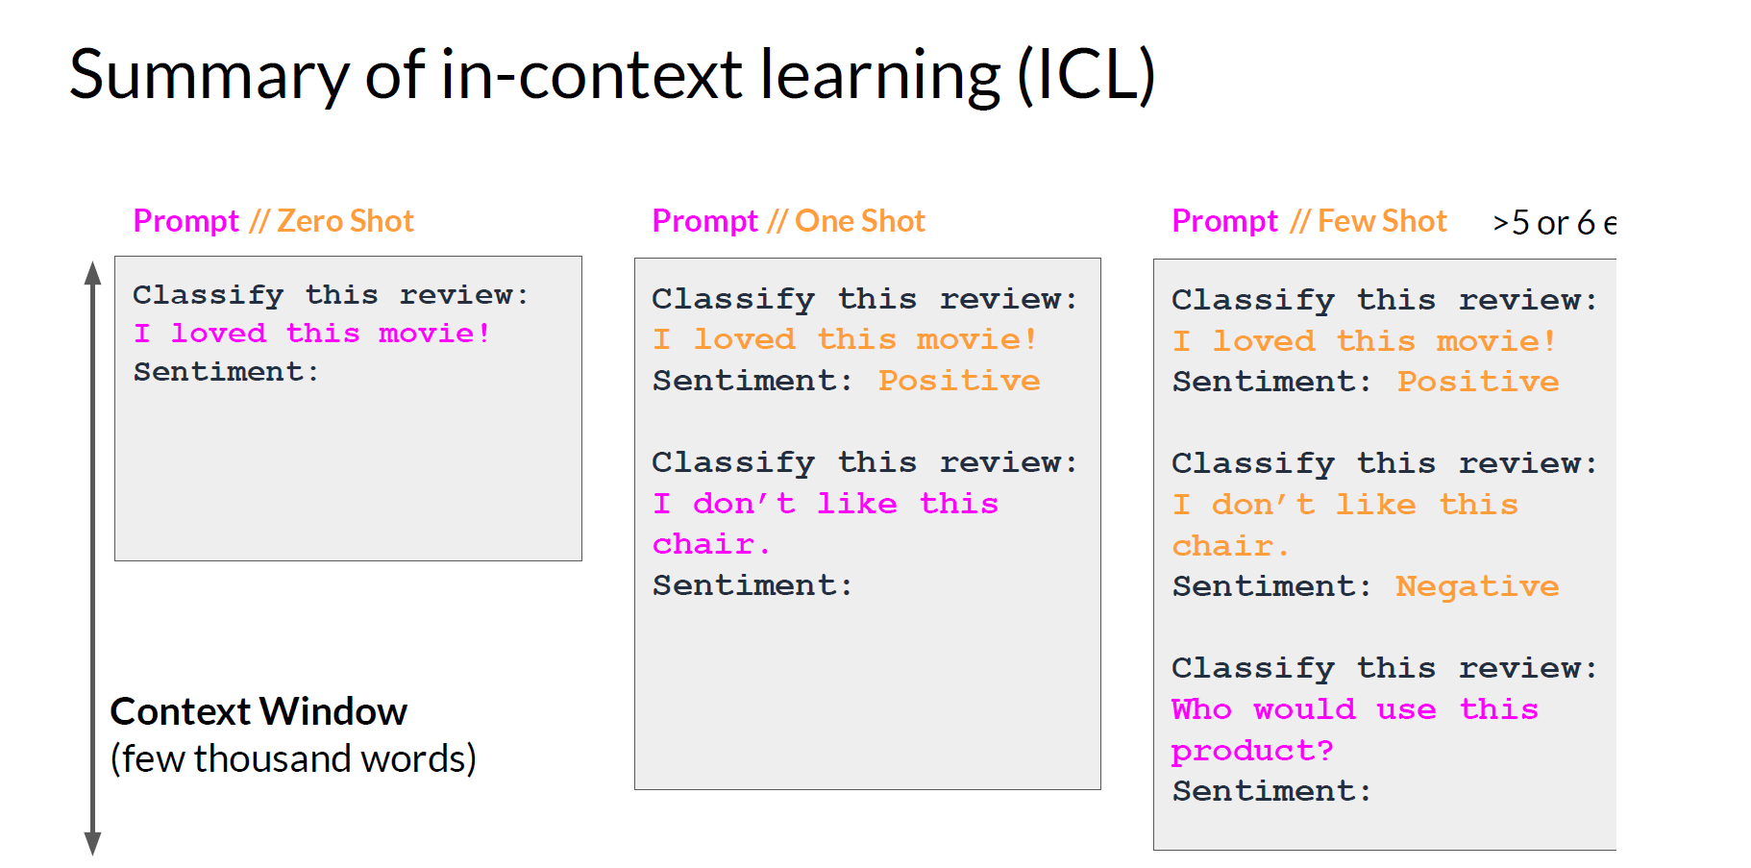
Generative AI & Large Language Models- deeplearning.ai

Slide 9
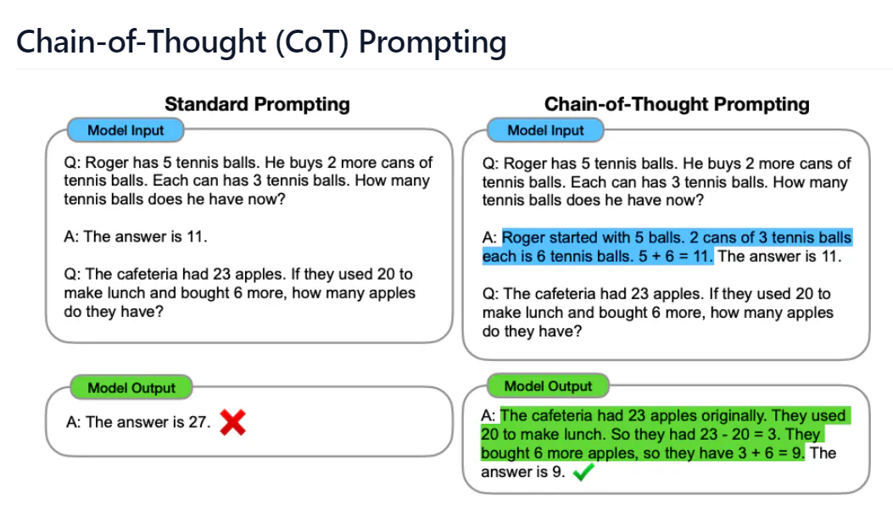
Chain-of-Thought Prompting Elicits Reasoning in Large Language Models, Wei et al. (2022)

Slide 10
Chain-of-Thought Prompting Elicits Reasoning in Large Language Models, Wei et al. (2022)

Slide 11
Lacks access to the external world
Inability to update its knowledge
Leads to issues like fact hallucination and error propagation.
Chain-of-Thought Prompting Elicits Reasoning in Large Language Models, Wei et al. (2022)

Slide 12
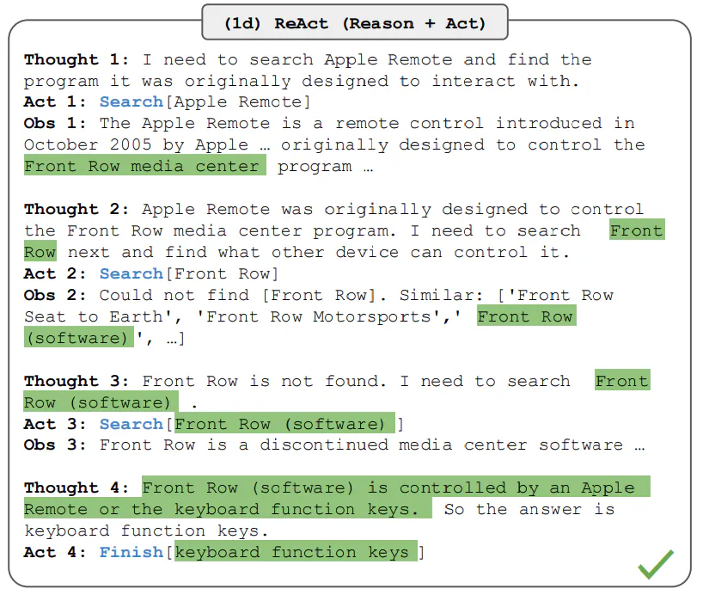
ReAct
Prompt: Aside from the Apple Remote, what other devices can control the program Apple Remote was originally designed to interact with?
ReAct: Synergizing Reasoning and Acting in Language Models Yao et al., (2023)

Slide 13
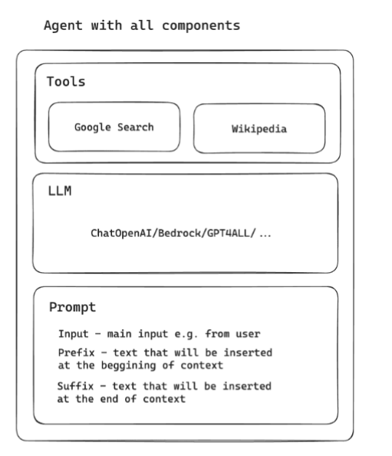
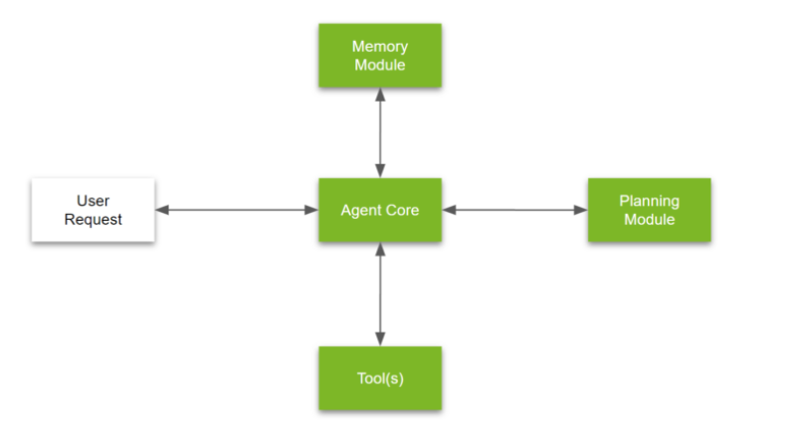
Agents
https://developer.nvidia.com/blog/introduction-to-llm-agents/
https://brightinventions.pl/blog/introducing-langchain-agents-tutorial-with-example/

Slide 14
RAG
Retrieval Augmented Generation

Slide 15


RAG

Slide 16
RAG
Chunks
Chunk a,b,c
Chunk d,e
api calls
api calls
Prompt
Which dragon did Jon Snow ride
LLM

Slide 17
RAG
Chunks
Prompt
Query = Which dragon did Jon Snow ride?
+ Context =
api call
LLM

Slide 18
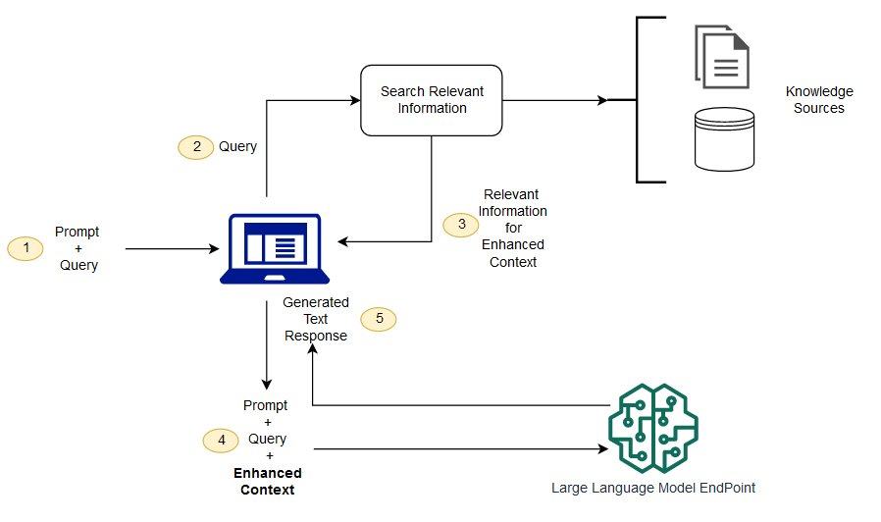
RAG
https://docs.aws.amazon.com/sagemaker/latest/dg/jumpstart-foundation-models-customize-rag.html

